Slide 1
ENSE 470 Milestone 6
Jeremy Cross
Iden Ellia
Abdullah Alasmari

Slide 2
Executive summary
Technology used
MYSQL
PHP
C#
We managed to accomplish all of our functionality for our release 1(MVP)
Nothing needed to be pushed to release 2
Our application mostly follows or lo-fi models, with some minor changes
Lo-fi models available on our GitHub page in milestone 6 folder

Slide 3
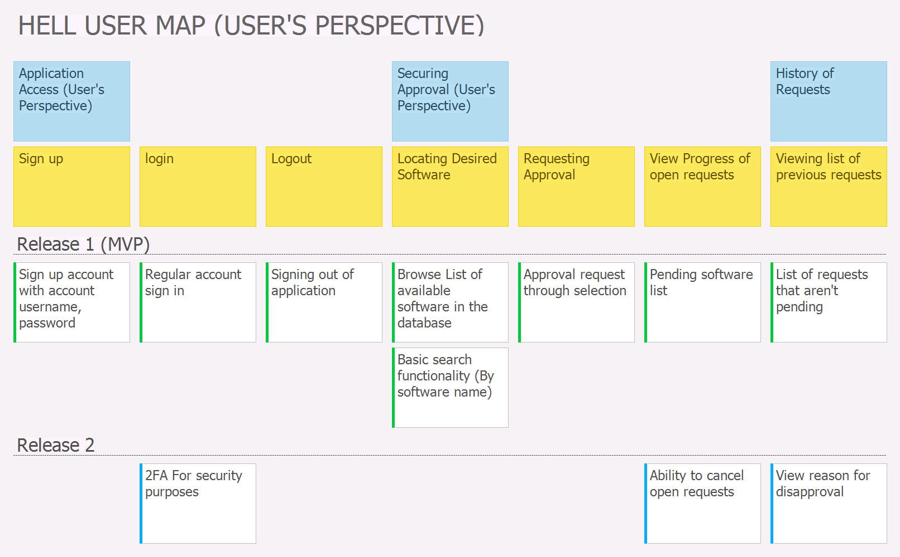

Slide 4
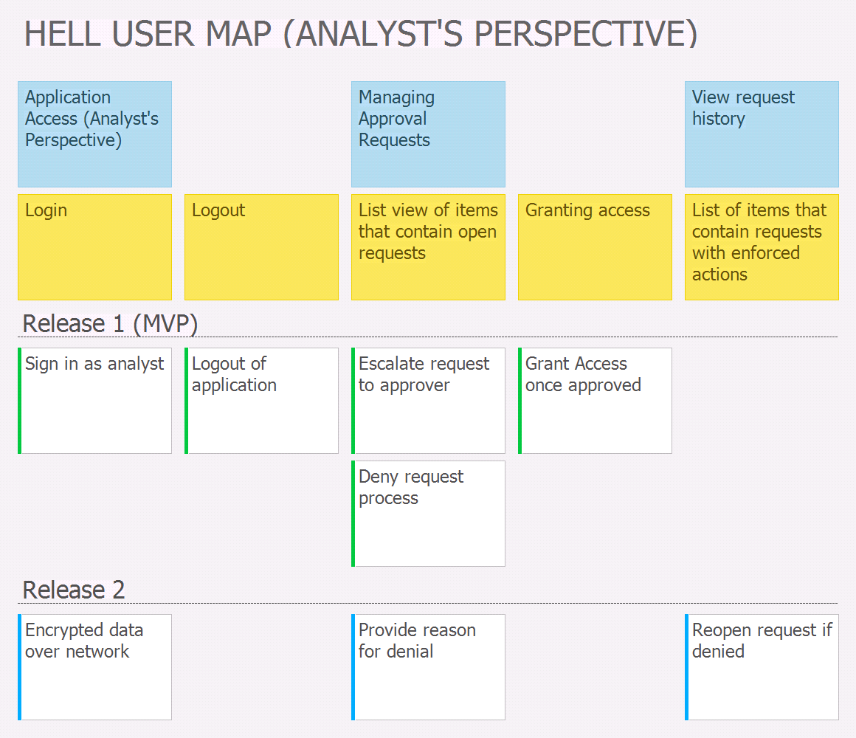

Slide 5
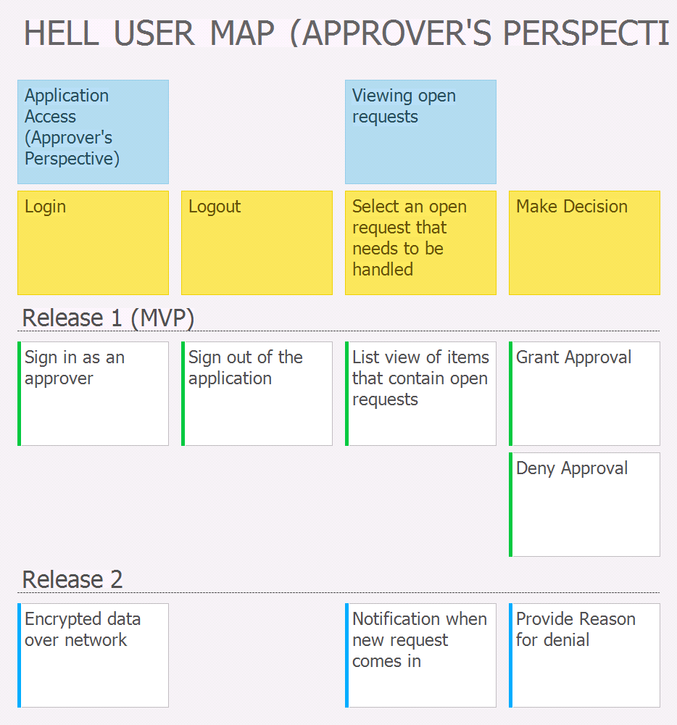

Slide 6
Demo
Some of the themes From our ATDD templates that we will demonstrate are:
Valid login information (all)
Logout functionality (all)
Software list (Users)
List of approved software (Users)
Approve software (Approver)
Deny Software (Approver)
Granting access to the software (analyst)
Denying access to the software (analyst)
More detailed ATDD templates available on our GitHub page in milestone 6 folder
Design patterns used?
Factory pattern: in order to create an instance of a web client with different settings
Singleton pattern: for the login session
Reflection Pattern: to change the type of session at run time through MSIL dynamic manipulation

Slide 7
Group reflection
How did you feel about this milestone? What did you like about it? What did you dislike?
Search functionality was difficult
Databases were tedious
What did you learn about yourself as you collaborated and worked through this milestone?
How to take the ideas from or Lo-Fi models and ATDD templates and incorporate them in to the application
How will you use what you have learned going forward?
The overall process for the project will be useful of future projects
We will build upon what we have for our second release
What “stuff & things” related to this milestone would you want help with?
For the most part I think we were good

